Slide 1



PROBLEM STATEMENT:
Anomaly Detection in Healthcare Data
Anomaly detection in healthcare data is an essential process that helps identify unusual patterns or outliers within large datasets. By uncovering these anomalies, healthcare providers can gain valuable insights, optimize operations, and enhance patient care. This presentation will guide you through the key steps involved in this data-driven approach, from preprocessing and clustering to machine learning algorithms and deep learning techniques.

Slide 2

Dataset Details
This dataset is designed for detecting healthcare fraud using unsupervised learning techniques. It contains information on healthcare providers, including detailed data about their identities, locations, and the services they provide. The goal is to identify anomalies that could indicate fraudulent activities, which is crucial given the significant financial impact of healthcare fraud on society.
Dataset Details- Original Size: 1,000,00 rows and 27 columns- Post-Processing Size: 1,00,000 rows and 15 columns
Key Variables1. Provider Information: - npi: National Provider Identifier - nppes_provider_last_org_name: Last name or organization name - nppes_provider_first_name: First name - nppes_provider_mi: Middle initial - nppes_credentials: Provider's credentials - nppes_provider_gender: Provider's gender - nppes_entity_code: Entity type (Individual or Organization) - nppes_provider_street1: First line of street address - nppes_provider_street: Second line of street address - nppes_provider_city: City - nppes_provider_zip: ZIP code - nppes_provider_state: State - nppes_provider_country: Country2.
Service Information: - provider_type: Provider specialty code - medicare_participation_indicator: Medicare participation status - place_of_service: Place of service (Facility or Non-facility) - hcpcs_code: HCPCS code for medical service - hcpcs_description: Description of the HCPCS code - hcpcs_drug_indicator: Drug indicator for the service3.
Service Metrics: - line_srvc_cnt: Number of services provided - bene_unique_cnt: Number of distinct beneficiaries - bene_day_srvc_cnt: Number of beneficiary/day services - average_Medicare_allowed_amt: Average Medicare allowed amount - stdev_Medicare_allowed_amt: Standard deviation of Medicare allowed amounts - average_submitted_chrg_amt: Average submitted charge amount - stdev_submitted_chrg_amt: Standard deviation of submitted charge amounts - average_Medicare_payment_amt: Average Medicare payment amount
Usage : The dataset can be used to apply various unsupervised learning techniques to identify anomalies, potentially uncovering fraudulent activities by healthcare providers

Slide 3

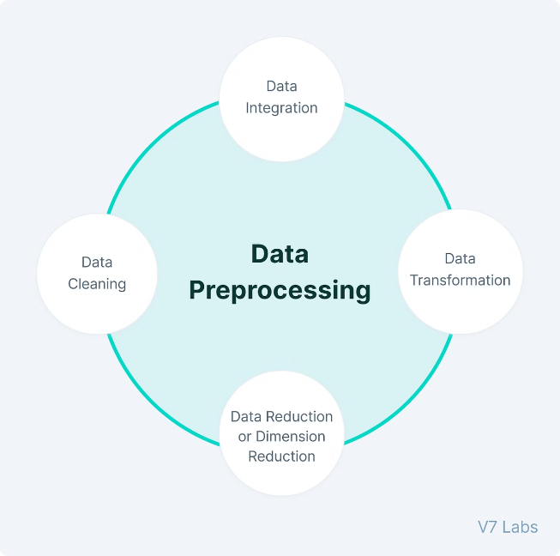
Preprocessing Step
1
Data Cleaning
2
Feature Engineering
The first step in anomaly detection is to ensure the data is clean and free of errors or missing values. This involves identifying and addressing any inconsistencies, outliers, or irrelevant data points that could skew the analysis.
Next, the data is transformed and enriched through feature engineering. This process involves creating new derived features that can provide more meaningful insights and improve the accuracy of the anomaly detection models.
3
Dimensionality Reduction
To optimize the analysis, the number of features is often reduced through techniques like principal component analysis (PCA) or t-SNE. This helps to identify the most informative and influential variables while minimizing computational complexity.

Slide 4
Objective:
To clean, preprocess, and analyze a dataset of Medicare providers to understand service patterns and financials.
Data Overview:
- Initial dataset: 100,000 entries with 27 columns- Key columns: Provider names, identifiers, credentials, gender, addresses, HCPCS codes, service numbers, and financial amounts.
Data Cleaning:
1.Combining Names:
- Created a full name column by merging first, middle, and last names.
- Removed original name columns to streamline the dataset.
2. Removing Redundant Columns:
- Dropped address-related columns and HCPCS details to focus on provider and service information.
3. Handling Missing Values:
- Filled missing values in categorical columns (e.g., gender, credentials) with the mode.
- Converted numeric columns to appropriate data types and handled NaNs by filling with mean values.
4. Dropping Duplicates:
- Ensured the dataset contained unique records.

Slide 5
Data Transformation:
Frequency Encoding:
- Applied frequency encoding to categorical columns like provider credentials and gender to facilitate numerical analysis
2. Standardization:
- Standardized numeric columns to normalize the range of values, crucial for further machine learning applications.
Analysis:
Descriptive Statistics:
- Generated summary statistics to understand the distribution of services and financial metrics
2. Data Splitting:
- Split normalized data into training and testing sets (80-20 split) for future model training.
Outcome:
- Cleaned, processed, and ready-to-use dataset for further machine learning and data analysis tasks.- Set foundation for detailed insights into Medicare service patterns and provider financials.

Slide 6
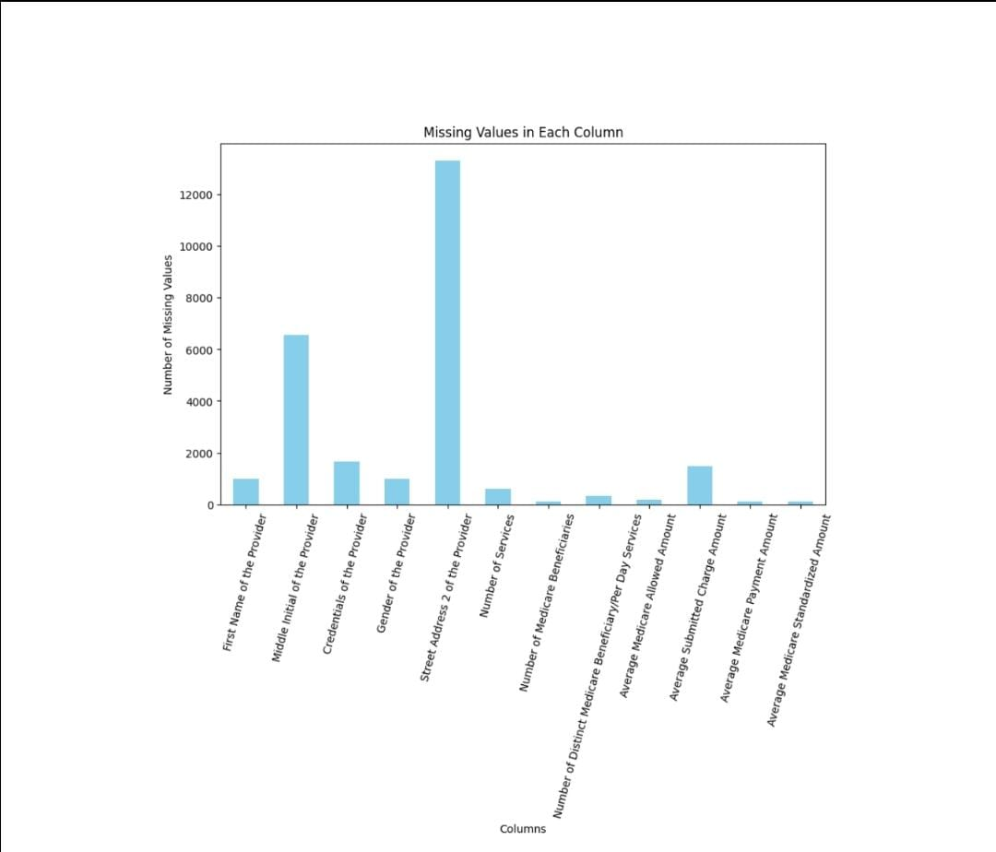
Missing Values Analysis:
Graph Interpretation:
- The graph displays missing values across various columns in the dataset.
- Columns with the highest missing values include "Street Address 2 of the Provider" (~12,000),
"Middle Initial of the Provider" (~6,500), and "Credentials of the Provider" (~1,600).
Actions Taken:
- Missing values in numeric columns were imputed with the mean values.
- Columns with excessive missing data that were not critical to the analysis were dropped.
Slide Content:
- Highlight the columns with the highest missing values.
- Explain the imputation strategy and rationale for dropping certain columns.

Slide 7
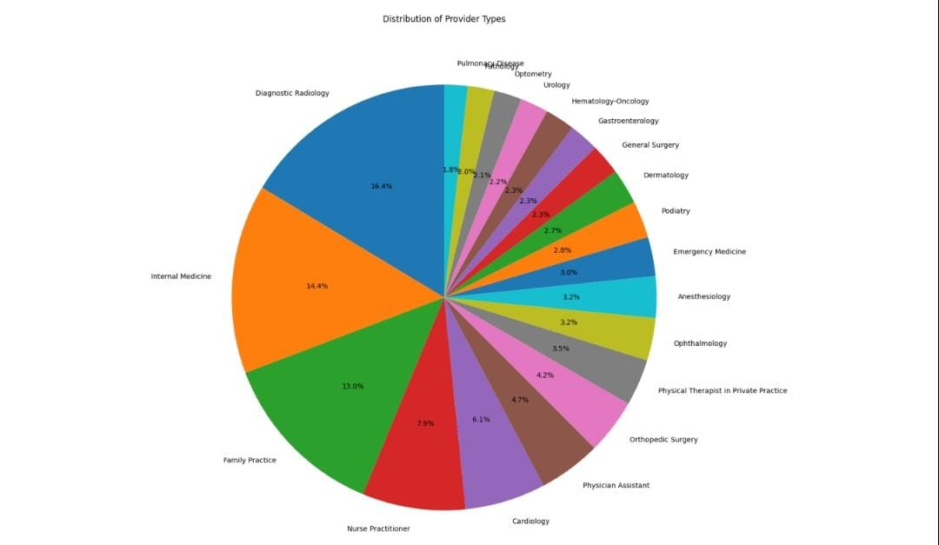
Distribution of Provider Types:
Graph Interpretation:
- The pie chart shows the distribution of different provider types in the dataset.
- The largest segments are "Family Practice" (33%), "Internal Medicine" (16.4%), and "Diagnostic Radiology" (14.4%).
- Other notable categories include "Nurse Practitioner" (7.9%), "Physician Assistant" (6.1%), and "Cardiology" (4.7%).
Insights:
- Family Practice and Internal Medicine together comprise almost 50% of the dataset.
- This distribution indicates a focus on general and internal healthcare services.
Slide Content:
- Display the pie chart.
- Discuss the major provider types and their proportions.
- Mention the implications for healthcare service focus.

Slide 8
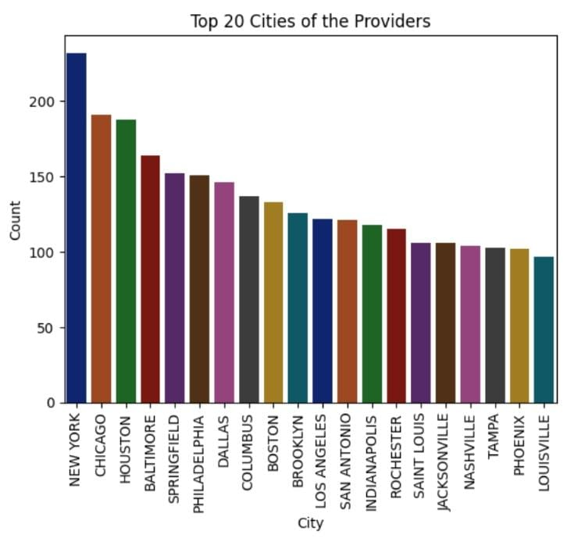
Top Cities of Providers:
Graph Interpretation:
- The bar plot ranks the top 20 cities with the highest number of Medicare providers.
- The X-axis lists the cities, and the Y-axis shows the count of providers.
- Example cities (with high counts) might include New York, Los Angeles, and Chicago.
Insights:
- Major metropolitan areas have the highest concentration of providers.
- This can reflect the higher demand for medical services in densely populated areas.
Slide Content:
- Show the bar plot of the top 20 cities.
- Highlight the cities with the most providers.
- Discuss possible reasons for the distribution, such as population density and healthcare demand.

Slide 9
Clustering Results
K-Means Clustering
One of the most commonly used clustering algorithms, K-Means, is applied to the preprocessed data. This technique groups similar data points together, creating distinct clusters that can help identify patterns and potential anomalies.
DBSCAN
DBSCAN is a density-based clustering algorithm that identifies clusters of various shapes and sizes in datasets, using parameters ε (maximum distance) and Min Pts (minimum points). It classifies points as core, border, or noise based on their density.

Slide 10
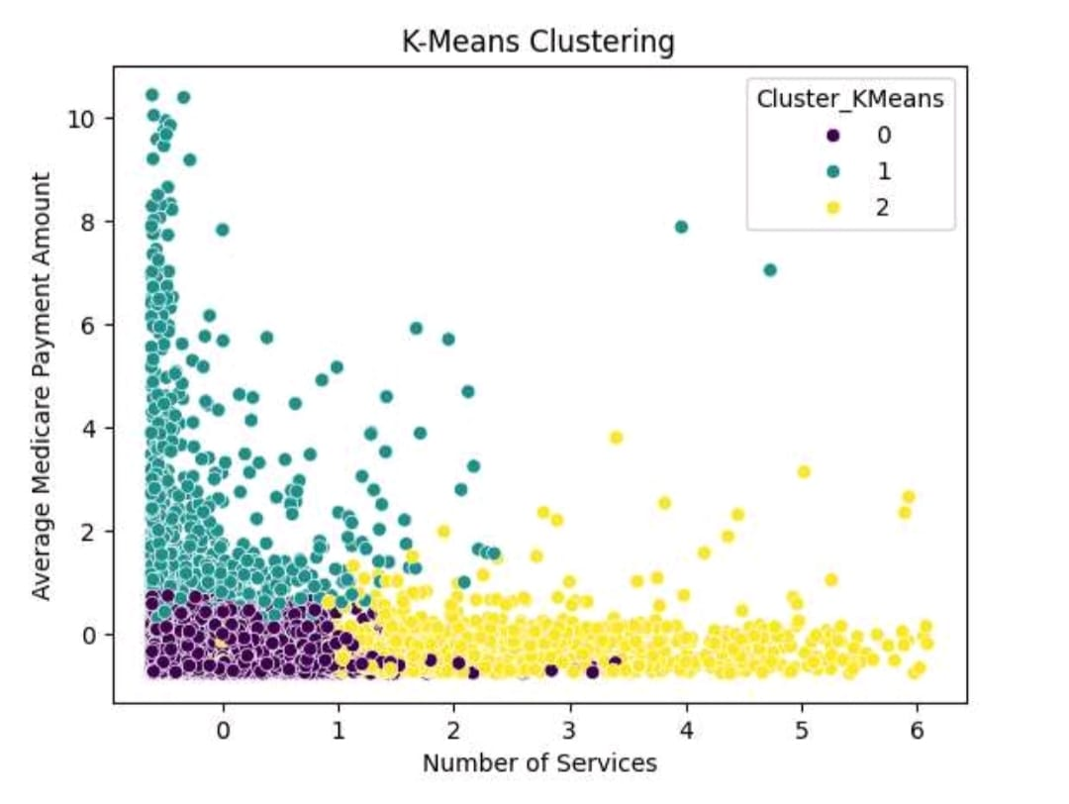
K-Means Clustering
Objective:
Clustering data points based on certain features.
Methodology:
Used K-Means algorithm with 3 clusters and a random state of 42.
Plot Description:
- X-axis: Number of Medicare Beneficiaries.
- Y-axis: Average Submitted Charge Amount.
- Clusters are visualized using different colors.
- Two distinct clusters are identified.

Slide 11
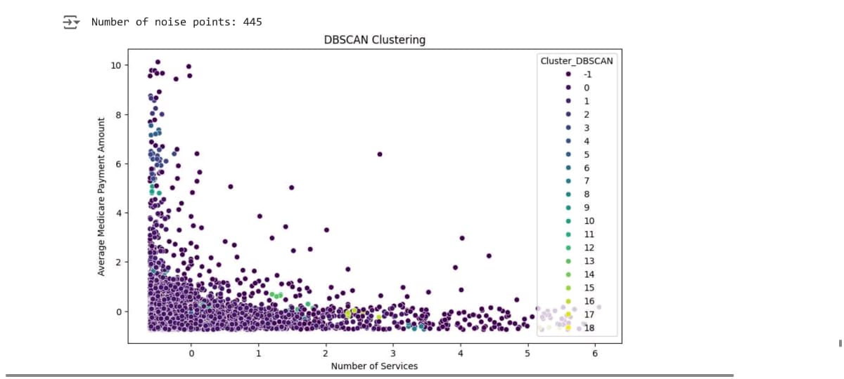
DBSCAN Clustering-
Objective:
Clustering data points to identify dense regions and noise.
Methodology:
Used DBSCAN algorithm with different parameters.
Plot Descriptions
- Epsilon radius: 0.7.
- Minimum number of samples: 6.
- Identified 17 clusters and 788 noise points.

Slide 12

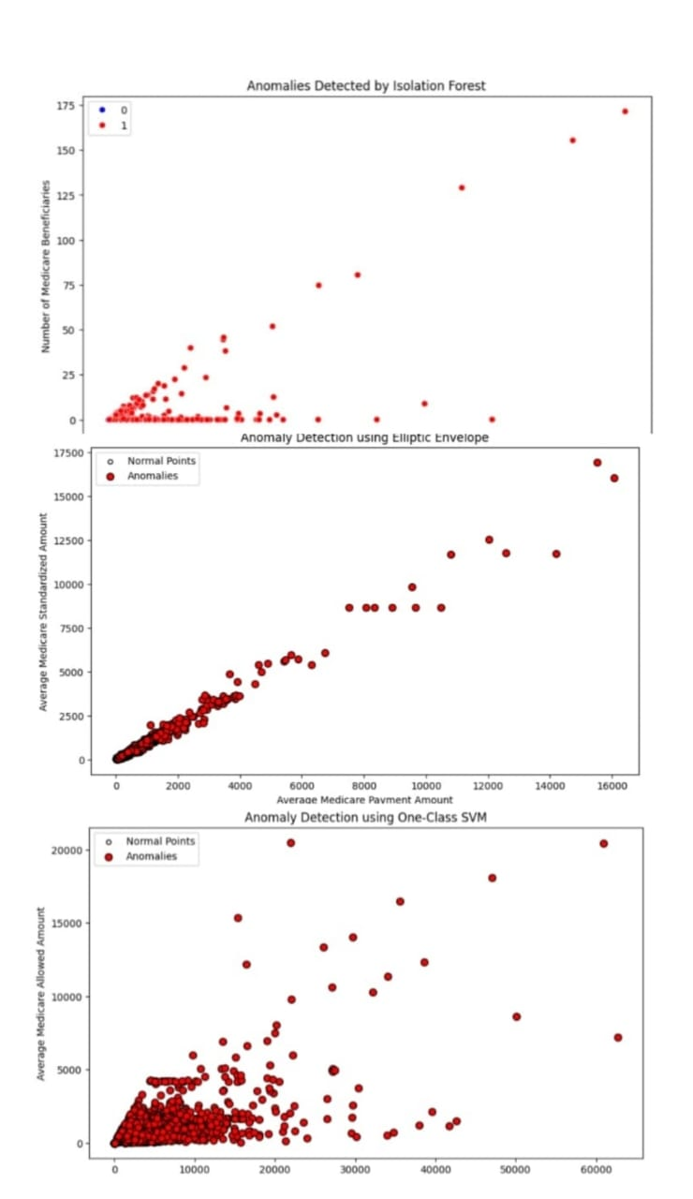
ML Algorithm Results
1
Isolation Forest
Isolation Forest is a powerful anomaly detection algorithm that works by isolating anomalies through a series of random cuts. This technique is particularly effective in identifying outliers within complex datasets.
2
One-Class SVM
One-Class Support Vector Machines (SVM) is another machine learning approach that learns a decision boundary around the normal data points, flagging any deviations as potential anomalies.
3
Elliptical Envelope
Elliptic Envelope is a method for detecting outliers in data by fitting an ellipse to the central distribution. It assumes the data follows a Gaussian distribution and calculates the Mahalanobis distance to identify points that fall outside the ellipse, marking them as outliers.

Slide 13
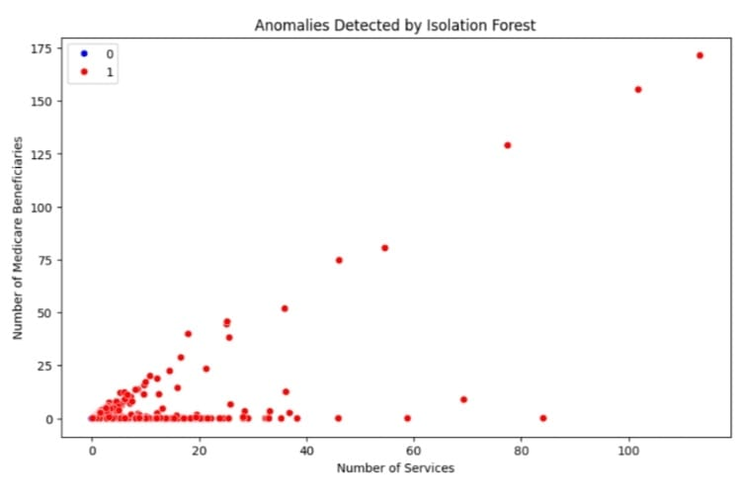
Isolation Forest:
Visualization of Inliers vs. Outliers:
- A scatter plot is used to display the results of the Isolation Forest algorithm.
Features:
- Number of Medicare Beneficiaries
- Number of Services
Plot Details:
- Inliers are shown in blue, while outliers are shown in red.
- Jitter is added to the data points to prevent overlap and enhance clarity.
- Axes are labeled with the feature names.

Slide 14
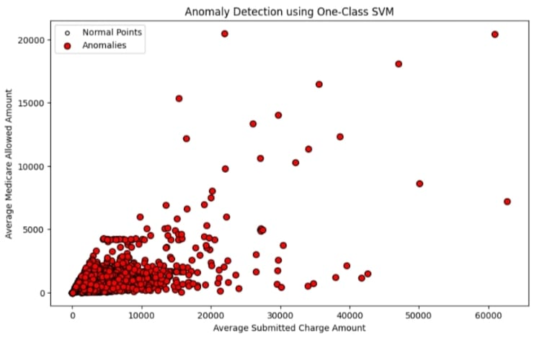
One-Class SVM:
Anomaly Detection Plot:
- A scatter plot is used to visualize the normal points and anomalies detected by the One-Class SVM algorithm.
Features:
- Average Submitted Charge Amount
- Average Medicare Allowed Amount
Plot Details:
- Normal points are plotted in white with black edges.
- Anomalies are highlighted in red with black edges.
- The plot includes a legend to differentiate between normal points and anomalies.
- Axes are labeled with the feature names.

Slide 15
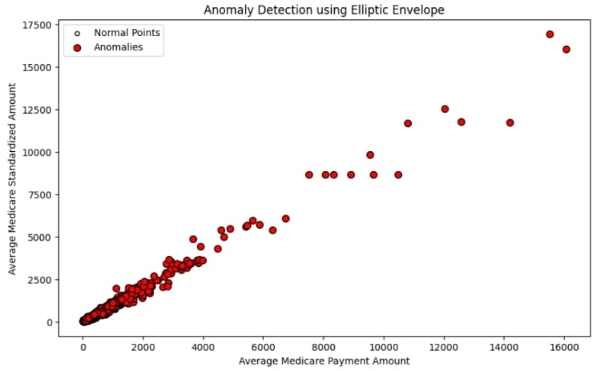
Elliptic Envelope:
Anomaly Detection Visualization:
- Another scatter plot is used to show the results of the Elliptic Envelope method.
Features:
- Average Medicare Payment Amount
- Average Medicare Standardized Amount
Plot Details:
- Normal points are shown in white with black edges.
- Anomalies are depicted in red with black edges.
- The plot includes a legend and labeled axes.

Slide 16

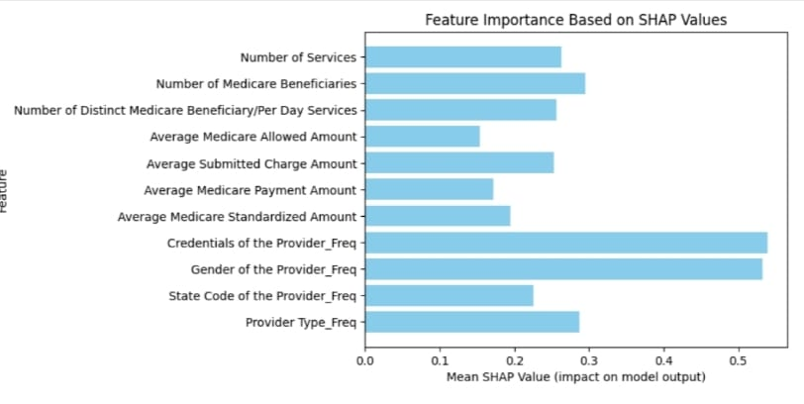
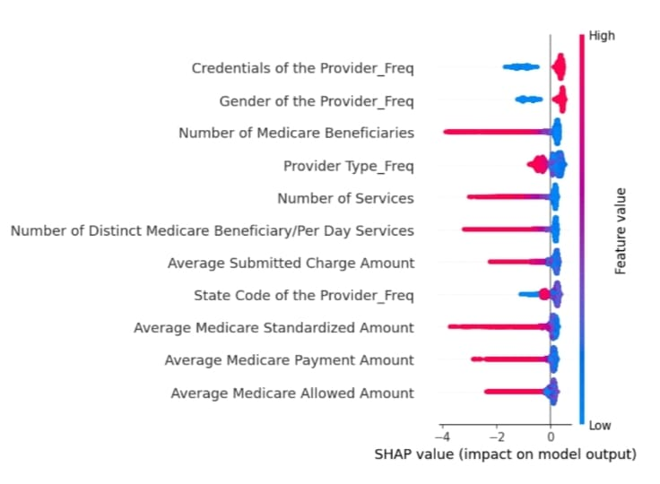
SHAP Results
Feature Importance
Interaction Effects
SHAP (Shapley Additive Explanations) is a powerful technique that quantifies the importance of each feature in the anomaly detection model. This helps healthcare providers understand which variables are the most influential in identifying outliers.
SHAP also reveals the interaction effects between different features, providing valuable insights into how various factors contribute to the identification of anomalies within the healthcare data.
Interpretability
Actionable Insights
By providing a clear and interpretable explanation of the model's predictions, SHAP enhances the transparency and trust in the anomaly detection process, allowing healthcare providers to make more informed decisions.
The SHAP results can be leveraged to develop targeted interventions and strategies to address the identified anomalies, leading to improved operational efficiency and enhanced patient outcomes.

Slide 17


Deep Learning Results
Autoencoders
Autoencoder models can learn efficient representations of healthcare data, allowing them to effectively detect outliers and anomalies by identifying data points that deviate significantly from the learned patterns.
Autoencoders are a type of artificial neural network used for unsupervised learning of efficient codings. They consist of an encoder that compresses the input into a latent-space representation and a decoder that reconstructs the input from this representation. The goal is to minimize the reconstruction error, ensuring the output is as close to the input as possible.
Autoencoders are used for dimensionality reduction, feature learning, and anomaly detection. Variants like convolutional autoencoders (for image data) and variational autoencoders (which introduce probabilistic elements) enhance their application in fields like image processing and generative modeling

Slide 18
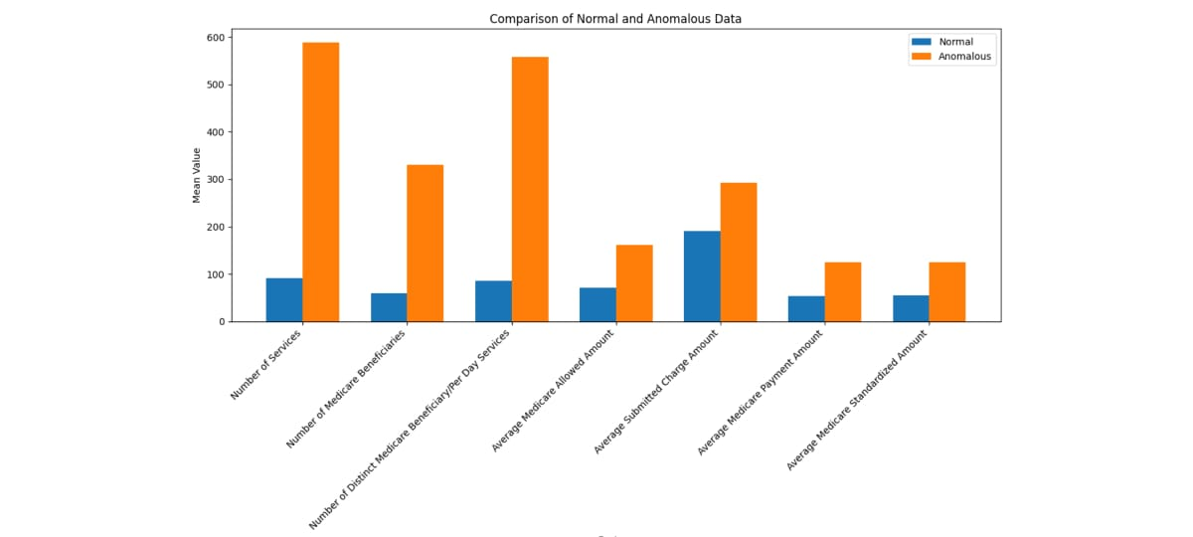
Comparison of Normal and Anomalous Data:
- The bar chart compares the mean values of several metrics between normal (blue bars) and anomalous (orange bars) data.
- Metrics on the x-axis include:
- Number of Services
- Number of Medicare Beneficiaries
- Number of Distinct Medicare Beneficiaries per Day Services
- Average Medicare Allowed Amount
- Average Submitted Charge Amount
- Average Medicare Payment Amount
- Average Medicare Standardized Amount
1. The y-axis represents the mean values of these metrics.
2. Anomalous data consistently shows higher mean values across most metrics compared to normal data.

Slide 19
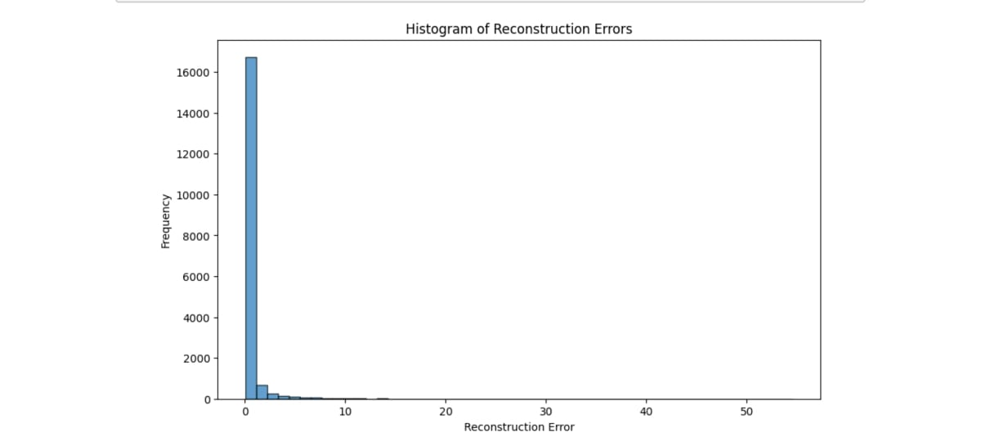
Histogram of Reconstruction Errors:
- The histogram shows the distribution of reconstruction errors.
- The x-axis represents the magnitude of reconstruction errors.
- The y-axis shows the frequency of each error magnitude.
- Most reconstruction errors are concentrated near zero, with a few outliers having higher errors.

